Slide 1
Quantum DCT Generation
Realizing a quantum algorithm to calculate DCT coefficients for signal and image processing.

Slide 2
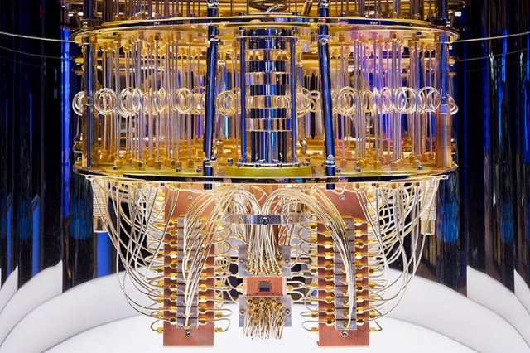
Introduction
Quantum computing is an emerging technology.
It’s application to digital signal and image processing may offer capabilities that surpass their traditional equivalents, in terms of security, storage and computing speed.
1

Slide 3
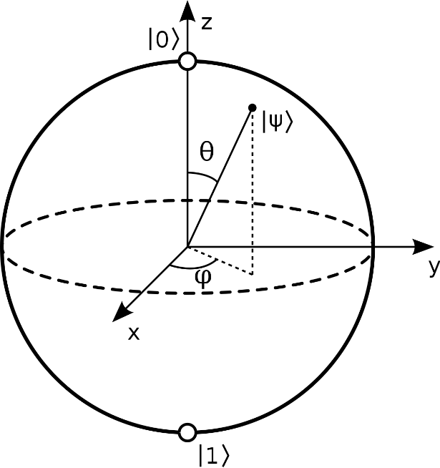
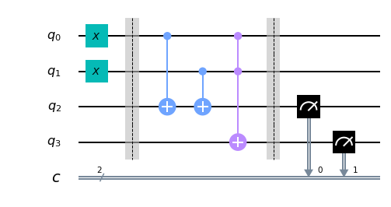
Aims and Objectives
Develop an elementary understanding of quantum information theory.
Explore the applications of quantum algorithms.
Take an algorithm, evaluate it’s feasibility and build a quantum circuit to test it.
2

Slide 4
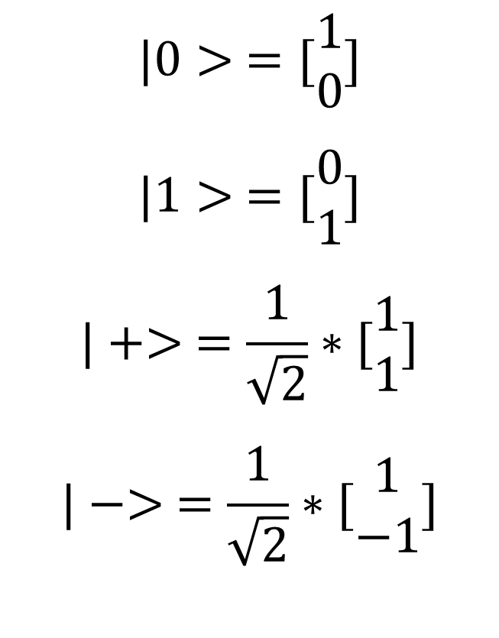
Background
$$|0> =[\begin{matrix}1 \\ 0\end{matrix}]$$
$$|1> =[\begin{matrix}0 \\ 1\end{matrix}]$$
$$|+> =\frac{1}{\sqrt{2}}∗[\begin{matrix}1 \\ 1\end{matrix}]$$
$$|−> =\frac{1}{\sqrt{2}}∗[\begin{matrix}1 \\ −1\end{matrix}]$$
Quantum Information Science
A brief introduction
Qubits can exist in a superposition of states.
When observed, the superposition will collapse into one state depending on the probability amplitude of each state.
Can manipulate this probability amplitude to have a higher chance of measuring states we want.
Any operation on a qubit must be unitary and hence reversible, therefore traditional gates will not work.
3

Slide 5
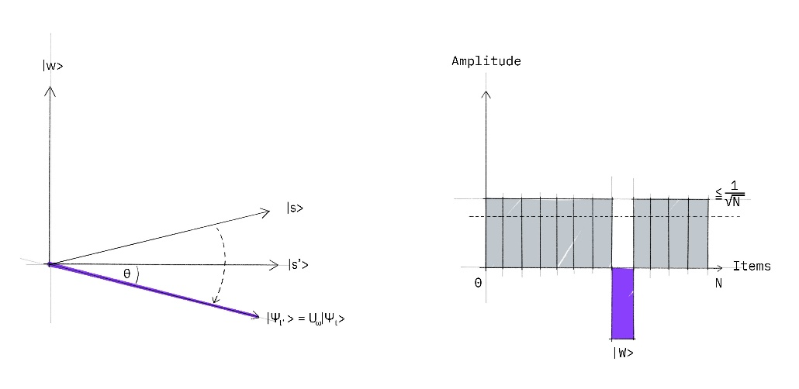
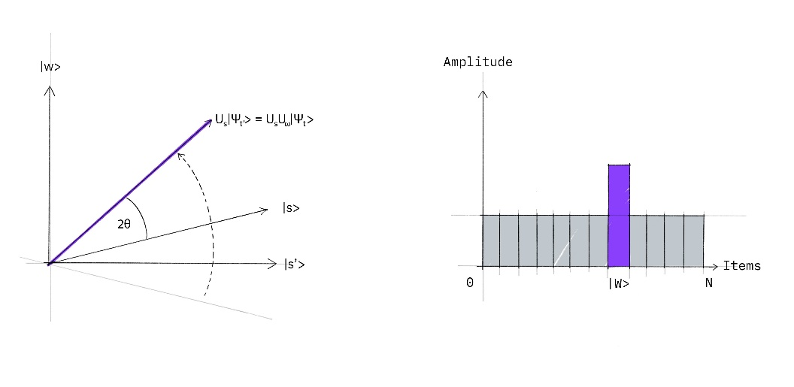

Background
Quantum Information Science
Grover’s Algorithm
Handy way of running an unstructured database search.
Has a runtime of O($\sqrt{N/m}$).
Works by ‘marking’ the values you want. This is done by inverting the phase.
We then amplify the amplitude of the marked value and reduce the amplitude of everything else.
4

Slide 6
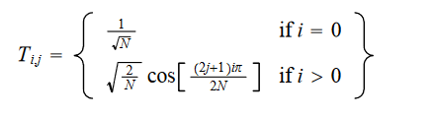
Background
Discrete Cosine Transform
Can transform a signal into a sum of cosine waves of different frequencies.
Has the property that much of the energy is represented by lower frequency waves.
Can remove the higher frequency waves by setting them to zero, reducing the size.
We then apply the inverse DCT to get back the original signal without much change.
5

Slide 7
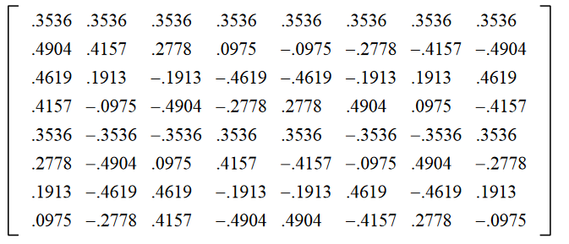
Background
Discrete Cosine Transform
Can transform a signal into a sum of cosine waves of different frequencies.
Has the property that much of the energy is represented by lower frequency waves.
Can remove the higher frequency waves by setting them to zero, reducing the size.
We then apply the inverse DCT to get back the original signal without much change.
6

Slide 8

Discrete Cosine Transform (1 D)
7

Slide 9
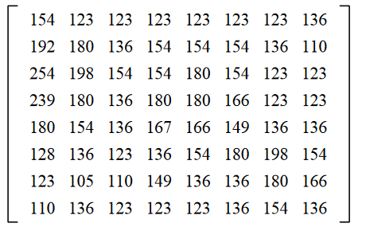
Discrete Cosine Transform (1 D)
8

Slide 10
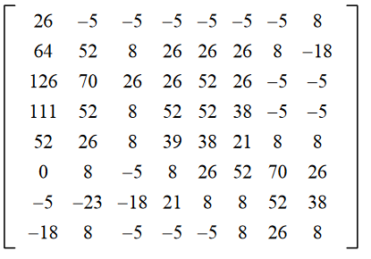
Discrete Cosine Transform (1 D)
- 128
9

Slide 11
Discrete Cosine Transform (1 D)
- 128
10

Slide 12
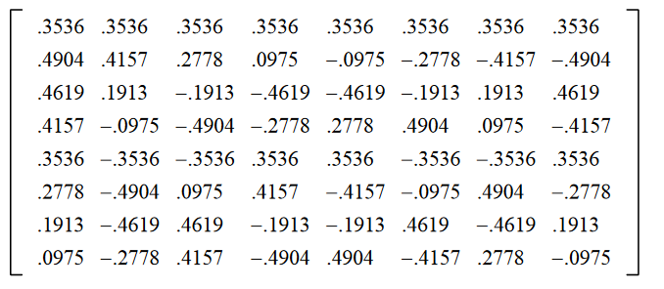
Discrete Cosine Transform (1 D)
- 128
X
11

Slide 13
Discrete Cosine Transform (1 D)
- 128
X
=
78.8 22.6 12.3 44.1 9.1 18.9 0.1 -4.7
12

Slide 14
Discrete Cosine Transform (1 D)
- 128
X
=
78.8 22.6 12.3 44.1 9.1 18.9 0.1 -4.7
78.8 22.6 12.3 44.1 9.1 18.9 0.1 -4.7
13

Slide 15
Discrete Cosine Transform (1 D)
- 128
X
=
78.8 22.6 12.3 44.1 9.1 18.9 0.1 -4.7
78.8 22.6 12.3 44.1 9.1 18.9 0.1 -4.7
X IDCT
14

Slide 16
Discrete Cosine Transform (1 D)
- 128
X
=
78.8 22.6 12.3 44.1 9.1 18.9 0.1 -4.7
78.8 22.6 12.3 44.1 9.1 18.9 0.1 -4.7
X IDCT
=
66 50 10 24 28 25 9 -18
15

Slide 17
Quantum DCT Algorithm
We want to calculate these coefficients that satisfy a certain criteria.
Can we do this without calculating them all?
Yes, using quantum superposition we can calculate all coefficients simultaneously and then increase the probability of measuring the ones we want.
16

Slide 18
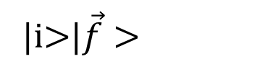
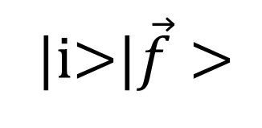
Quantum DCT Algorithm
Initialize State
|i> is in a superposition of all numbers between 0 and N-1
|i>|$\vec{f}>$
|i>|$\vec{f}>$
17

Slide 19
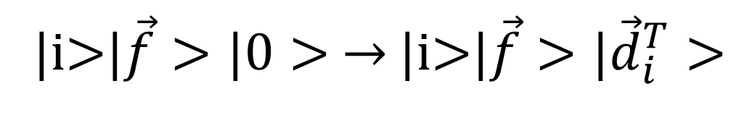
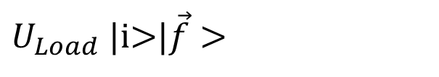
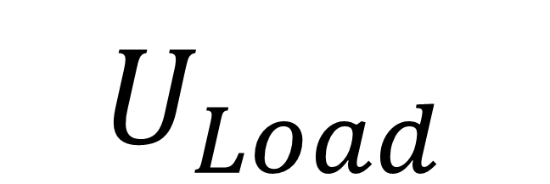
Quantum DCT Algorithm
$$U_{Load}$$
|i>|$\vec{f}>|0> →$ |i>|$\vec{f}>|{\vec{d}}_{i}^{T}>$
$U_{Load}$|i>|$\vec{f}>$
18

Slide 20
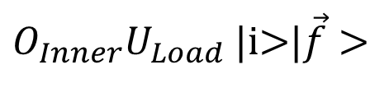

Quantum DCT Algorithm
$$O_{Inner}$$
|i>|$\vec{f}>|{\vec{d}}_{i}^{T}>|0>→$ |i>|$\vec{f}>|{\vec{d}}_{i}^{T}>\text{|}(\vec{f}.{\vec{d}}_{i}^{T})^{2}>$
${O_{Inner}U}_{Load}$|i>|$\vec{f}>$
19

Slide 21
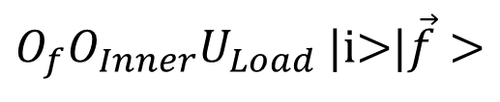

Quantum DCT Algorithm
$$O_{f}$$
|i>|$\vec{f}>|{\vec{d}}_{i}^{T}>\text{|}(\vec{f}.{\vec{d}}_{i}^{T})^{2} > →$ ${(−1)}^{f(i)}|$i>|$\vec{f}>|{\vec{d}}_{i}^{T}>\text{|}(\vec{f}.{\vec{d}}_{i}^{T})^{2}>$
f(i) = 1 if ($α$<= $\vec{(f}.{\vec{d}}_{i})^{2}$<=$β) else 0$
${{O_{f}O}_{Inner}U}_{Load}$|i>|$\vec{f}>$
20

Slide 22
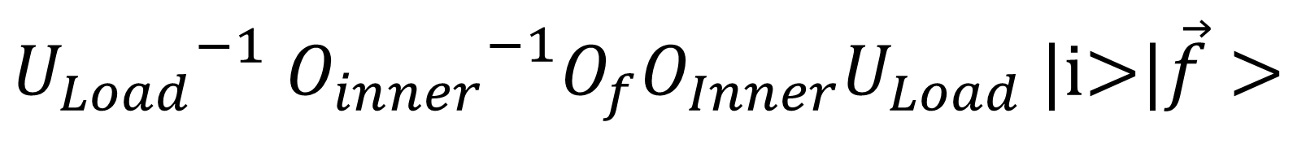
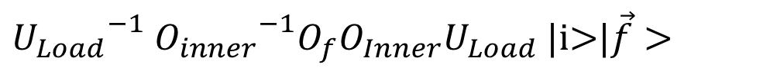
Quantum DCT Algorithm
Reverse Operations
${U_{Load}}^{−1} {O_{inner}}^{−1}{{O_{f}O}_{Inner}U}_{Load}$|i>|$\vec{f}>$
${U_{Load}}^{−1} {O_{inner}}^{−1}{{O_{f}O}_{Inner}U}_{Load}$|i>|$\vec{f}>$
21

Slide 23
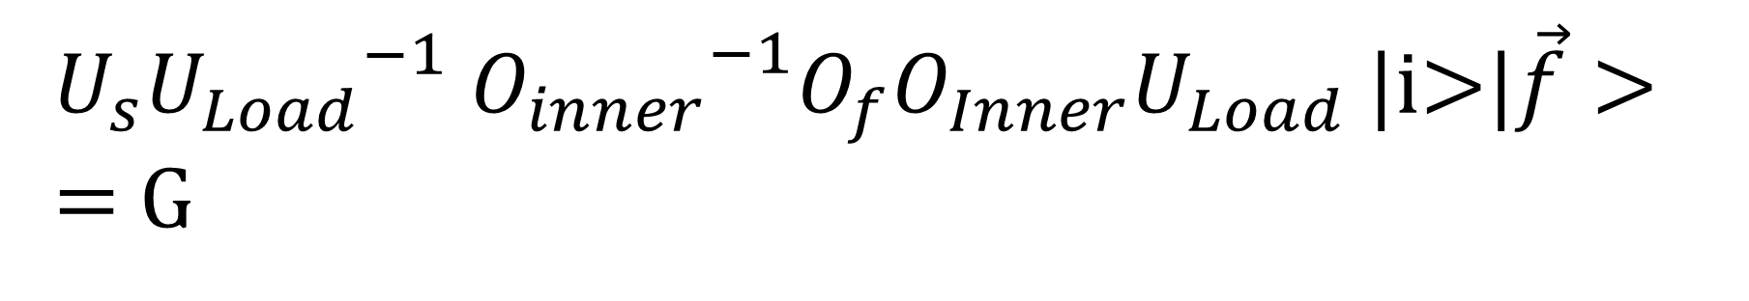
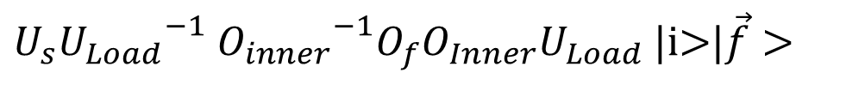
Quantum DCT Algorithm
Apply Grover’s Diffuser
$U_{s}{U_{Load}}^{−1} {O_{inner}}^{−1}{{O_{f}O}_{Inner}U}_{Load}$|i>|$\vec{f}>$ = G
$U_{s}{U_{Load}}^{−1} {O_{inner}}^{−1}{{O_{f}O}_{Inner}U}_{Load}$|i>|$\vec{f}>$
22

Slide 24
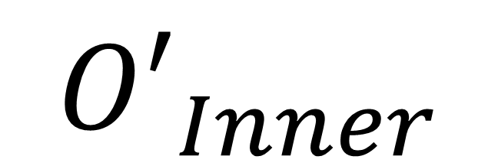
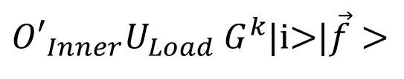
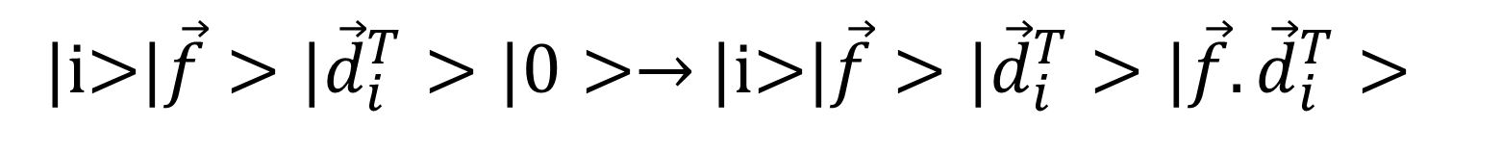
Quantum DCT Algorithm
$${O′}_{Inner}$$
|i>|$\vec{f}>|{\vec{d}}_{i}^{T}>|0>→$ |i>|$\vec{f}>|{\vec{d}}_{i}^{T}>\text{|}\vec{f}.{\vec{d}}_{i}^{T}>$
${{O′}_{Inner}U}_{Load} G^{k}$|i>|$\vec{f}>$
23

Slide 25
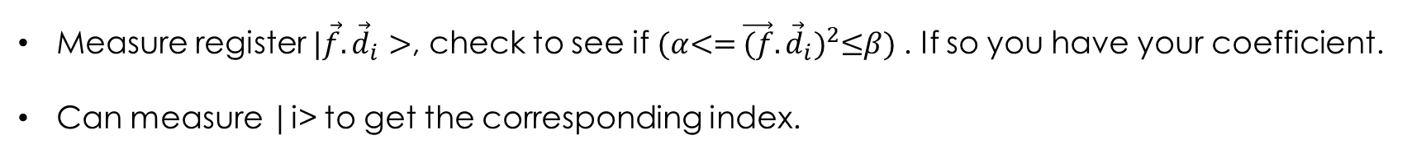
Quantum DCT Algorithm
Measure
Measure register $\text{|}\vec{f}.{\vec{d}}_{i}>$, check to see if ($α$<= $\vec{(f}.{\vec{d}}_{i})^{2}$≤$β)$. If so you have your coefficient.
Can measure |i> to get the corresponding index.
24

Slide 26
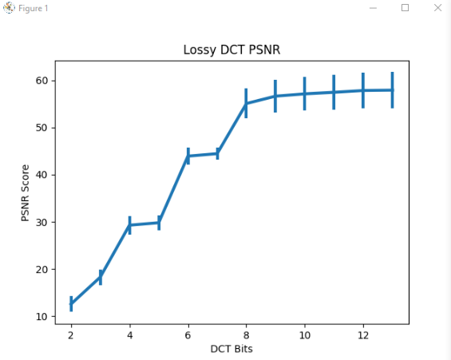
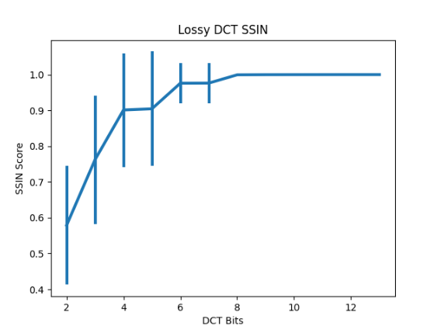
Quantum DCT Algorithm
Changes to Original Algorithm
DCT matrix contains floats, which are not currently supported by quantum computers.
Can be mitigated by multiplying each element by a constant to fit as an n bit integer.
This is a lossy step, but by increasing the size of n, we can reduce the energy lost.
n = 8 has a good trade off between size and information lost.
25

Slide 27
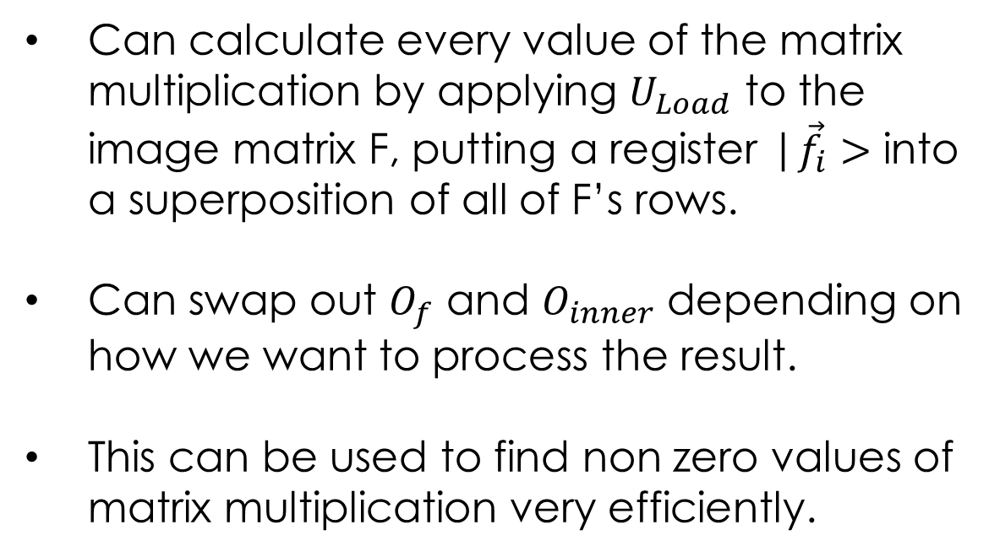
Other Applications
Can calculate every value of the matrix multiplication by applying $U_{Load}$ to the image matrix F, putting a register |${\vec{f}}_{i}>$ into a superposition of all of F’s rows.
Can swap out $O_{f}$ and $O_{inner}$ depending on how we want to process the result.
This can be used to find non zero values of matrix multiplication very efficiently.
26

Slide 28
Quantum DCT Algorithm
Summary
Can calculate DCT coefficients quite efficiently.
Converting the DCT matrix elements to integers does not lose too much information.
Subroutine can also be used for any problems requiring the evaluation of matrix multiplication.
27

Slide 29
Quantum DCT Algorithm
Summary
Can calculate DCT coefficients quite efficiently.
Converting the DCT matrix elements to integers does not lose too much information.
Subroutine can also be used for any problems requiring the evaluation of matrix multiplication.
Questions?
28

